Slide 1
OPERATING SYSTEMS
WEEK#6:Threads and Multithreading, User-level Threads
Kernel-level threads

Slide 2
Threads
The unit of dispatching is referred to as a thread or lightweight process

Slide 3
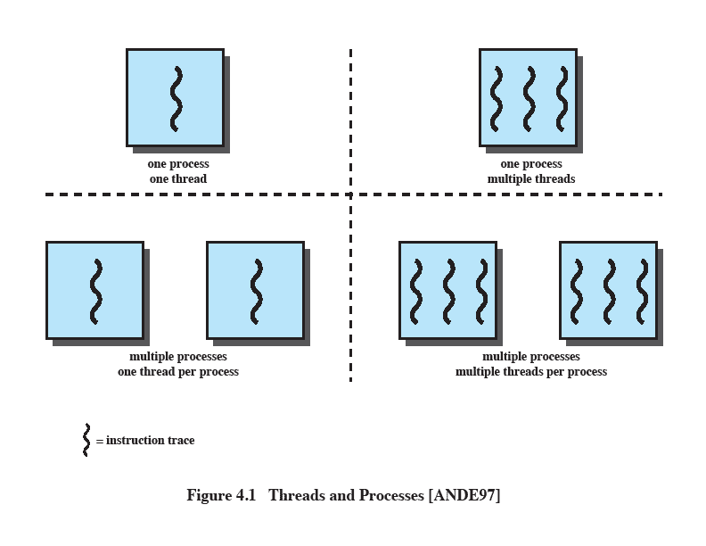
Multithreading
The ability of an OS to support multiple, concurrent paths of execution within a single process.
Notes:
Multithreading refers to the ability of an OS to support multiple, concurrent paths of execution within a single process.

Slide 4
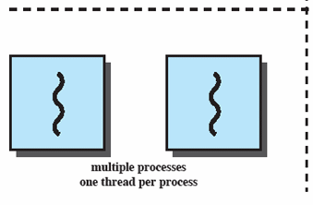
Single Thread Approaches
MS-DOS supports a single user process and a single thread.
Some UNIX, support multiple user processes but only support one thread per process
Notes:
Animated Slide
Onload Enlarges top-left to discuss DOS
Click1: Enlarges bottom-left for Unix
Single Threaded approach: The traditional approach of a single thread of execution per process, in which the concept of a thread is not recognized, examples are
MS DOS (single process, single thread)
Unix (multiple, single threaded processes)

Slide 5
Multithreading
Java run-time environment is a single process with multiple threads
Multiple processes and threads are found in Windows, Solaris, and many modern versions of UNIX
Notes:
Animated Slide
Onload: Emphasis on top-right and JRE (single process, multiple thread),
Click 1: Emphasis on multiple processes with multiple threads – this is the main topic of this chapter
JRE is an example of a system of one process with multiple threads.
Of main interest in this chapter is the use of multiple processes, each of which support multiple threads.
Examples include:
Windows,
Solaris,
and many modern versions of UNIX.

Slide 6
Processes
A virtual address space which holds the process image
Protected access to
Processors,
Other processes,
Files,
I/O resources
Notes:
In a multithreaded environment, a process is defined as the unit of resource allocation and a unit of protection.

Slide 7
One or More Threads in Process
Each thread has
An execution state (running, ready, etc.)
Saved thread context when not running
An execution stack
Some per-thread static storage for local variables
Access to the memory and resources of its process (all threads of a process share this)
Notes:
Within a process, there may be one or more threads, each with the following:
• A thread execution state (Running, Ready, etc.).
• A saved thread context when not running;
one way to view a thread is as an independent program counter operating within a process.

Slide 8
One view…
One way to view a thread is as an independent program counter operating within a process.

Slide 9
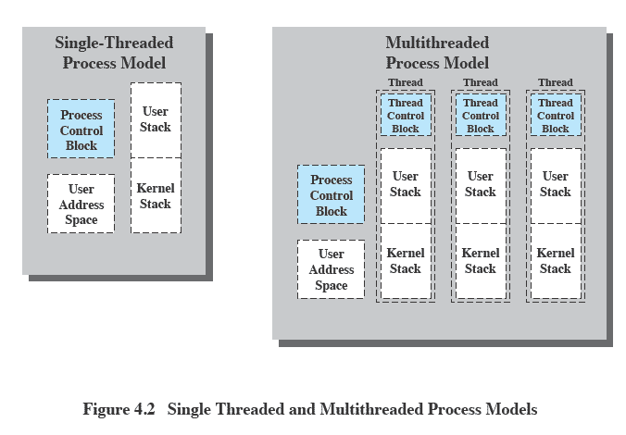
Threads vs. processes
Notes:
Distinction between threads and processes from the point of view of process management.
In a single-threaded process model, the representation of a process includes
its process control block
user address space,
user and kernel stacks to manage the call/return behaviour of the execution of the process.
While the process is running, it controls the processor registers. The contents of these registers are saved when the process is not running.
In a multithreaded environment,
there is still a single process control block and user address space associated with the process,
but separate stacks for each thread,
as well as a separate control block for each thread containing register values, priority, and other thread-related state information.
Thus, all of the threads of a process share the state and resources of that process.
They reside in the same address space and have access to the same data.
When one thread alters an item of data in memory, other threads see the results if and when they access that item.
If one thread opens a file with read privileges, other threads in the same process can also read from that file.

Slide 10
Benefits of Threads
Takes less time to create a new thread than a process
Less time to terminate a thread than a process
Switching between two threads takes less time that switching processes
Threads can communicate with each other
without invoking the kernel
Notes:
If there is an application or function that should be implemented as a set of related units of execution,
it is far more efficient to do so as a collection of threads - rather than a collection of separate processes.

Slide 11
Threads
Several actions that affect all of the threads in a process
The OS must manage these at the process level.
Examples:
Suspending a process involves suspending all threads of the process
Termination of a process, terminates all threads within the process
Notes:
Suspension involves swapping the address space of one process out of main memory to make room for the address space of another process.
Because all threads in a process share the same address space, all threads are suspended at the same time.
Similarly, termination of a process terminates all threads within that process.

Slide 12
Types of Threads
A thread consists of:
a thread execution state (Running, Ready, etc.)
a context (program counter, register set.)
an execution stack.
some per-tread static storage for local variables.
access to the memory and resources of its process (shared with all other threads in that process.)
OS resources (open files, signals, etc.)
Thus, all of the threads of a process share the state and resources of the parent process (memory space and code section.)
There are two types of threads:
User-space (ULT) and
Kernel-space (KLT).

Slide 13
User-level threads
User-level threads avoid the kernel and are managed by the process.
Often this is called "cooperative multitasking" where the task defines a set of routines that get "switched to" by manipulating the stack pointer.
Typically each thread "gives-up" the CPU by calling an explicit switch, sending a signal or doing an operation that involves the switcher.
A timer signal can force switching.
User threads typically can switch faster than kernel threads [however, Linux kernel threads' switching is actually pretty close in performance].

Slide 14
User-level threads
Disadvantages.
User-space threads have a problem that a single thread can monopolize the timeslice thus starving the other threads within the task.
Also, it has no way of taking advantage of SMPs (Symmetric MultiProcessor systems, e.g. dual-/quad-Pentiums).
Lastly, when a thread becomes I/O blocked, all other threads within the task lose the timeslice as well.
Solutions/work arounds.
Timeslice monopolization can be controlled with an external monitor that uses its own clock tick.
Some SMPs can support user-space multithreading by firing up tasks on specified CPUs then starting the threads from there [this form of SMP threading seems tenuous, at best].
Some libraries solve the I/O blocking problem with special wrappers over system calls, or the task can be written for nonblocking I/O.

Slide 15
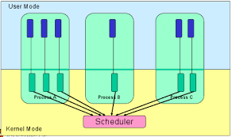
Kernel-Level Threads
KLTs often are implemented in the kernel using several tables (each task gets a table of threads).
The kernel schedules each thread within the timeslice of each process.
There is a little more overhead with mode switching from user to kernel mode because of loading of larger contexts, but initial performance measures indicate a negligible increase in time.

Slide 16
Advantages.
Since the clocktick will determine the switching times, a task is less likely to hog the timeslice from the other threads within the task.
I/O blocking is not a problem.
If properly coded, the process automatically can take advantage of SMPs and will run incrementally faster with each added CPU.

Slide 17
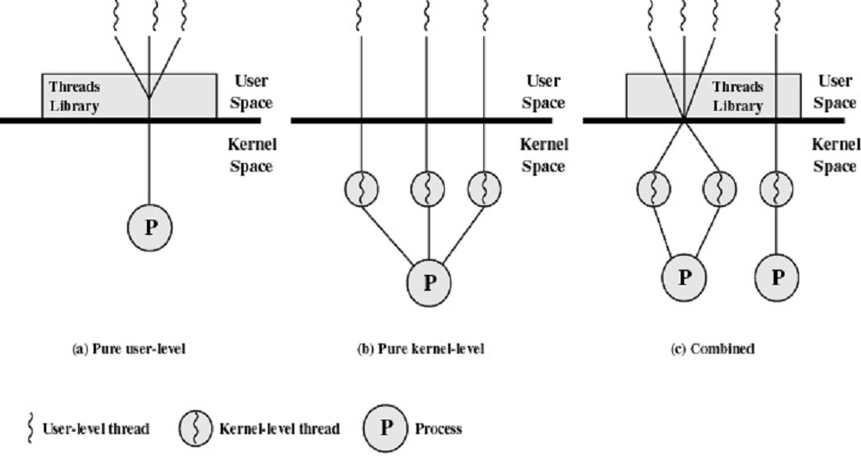
User-Level and Kernel-Level Threads

Slide 18
Parallel Processing
Parallel processing is a method of simultaneously breaking up and running program tasks on multiple microprocessors, thereby reducing processing time. Parallel processing may be accomplished via a computer with two or more processors or via a computer network.
Parallel processing is also called parallel computing.

Slide 19
Thank You!

